Slide 1


Design Ideas
First Slide in a New Presentation

Slide 2
Design Idea results may be different for you
Design Ideas is based upon a machine learning algorithm which is combined with the collection of clipart and design principles by Microsoft. These are always evolving and improving.
Therefore, you may get different results for the same input.
This presentation is a sample of the Design Ideas outputs I got for various types of inputs.

Slide 3
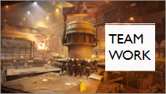
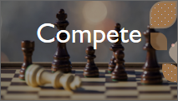
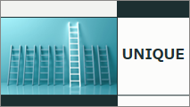




Slide 4
View from a plane is very nice

Slide 5

View from a plane is very nice

Slide 6
Whales are big

Slide 7
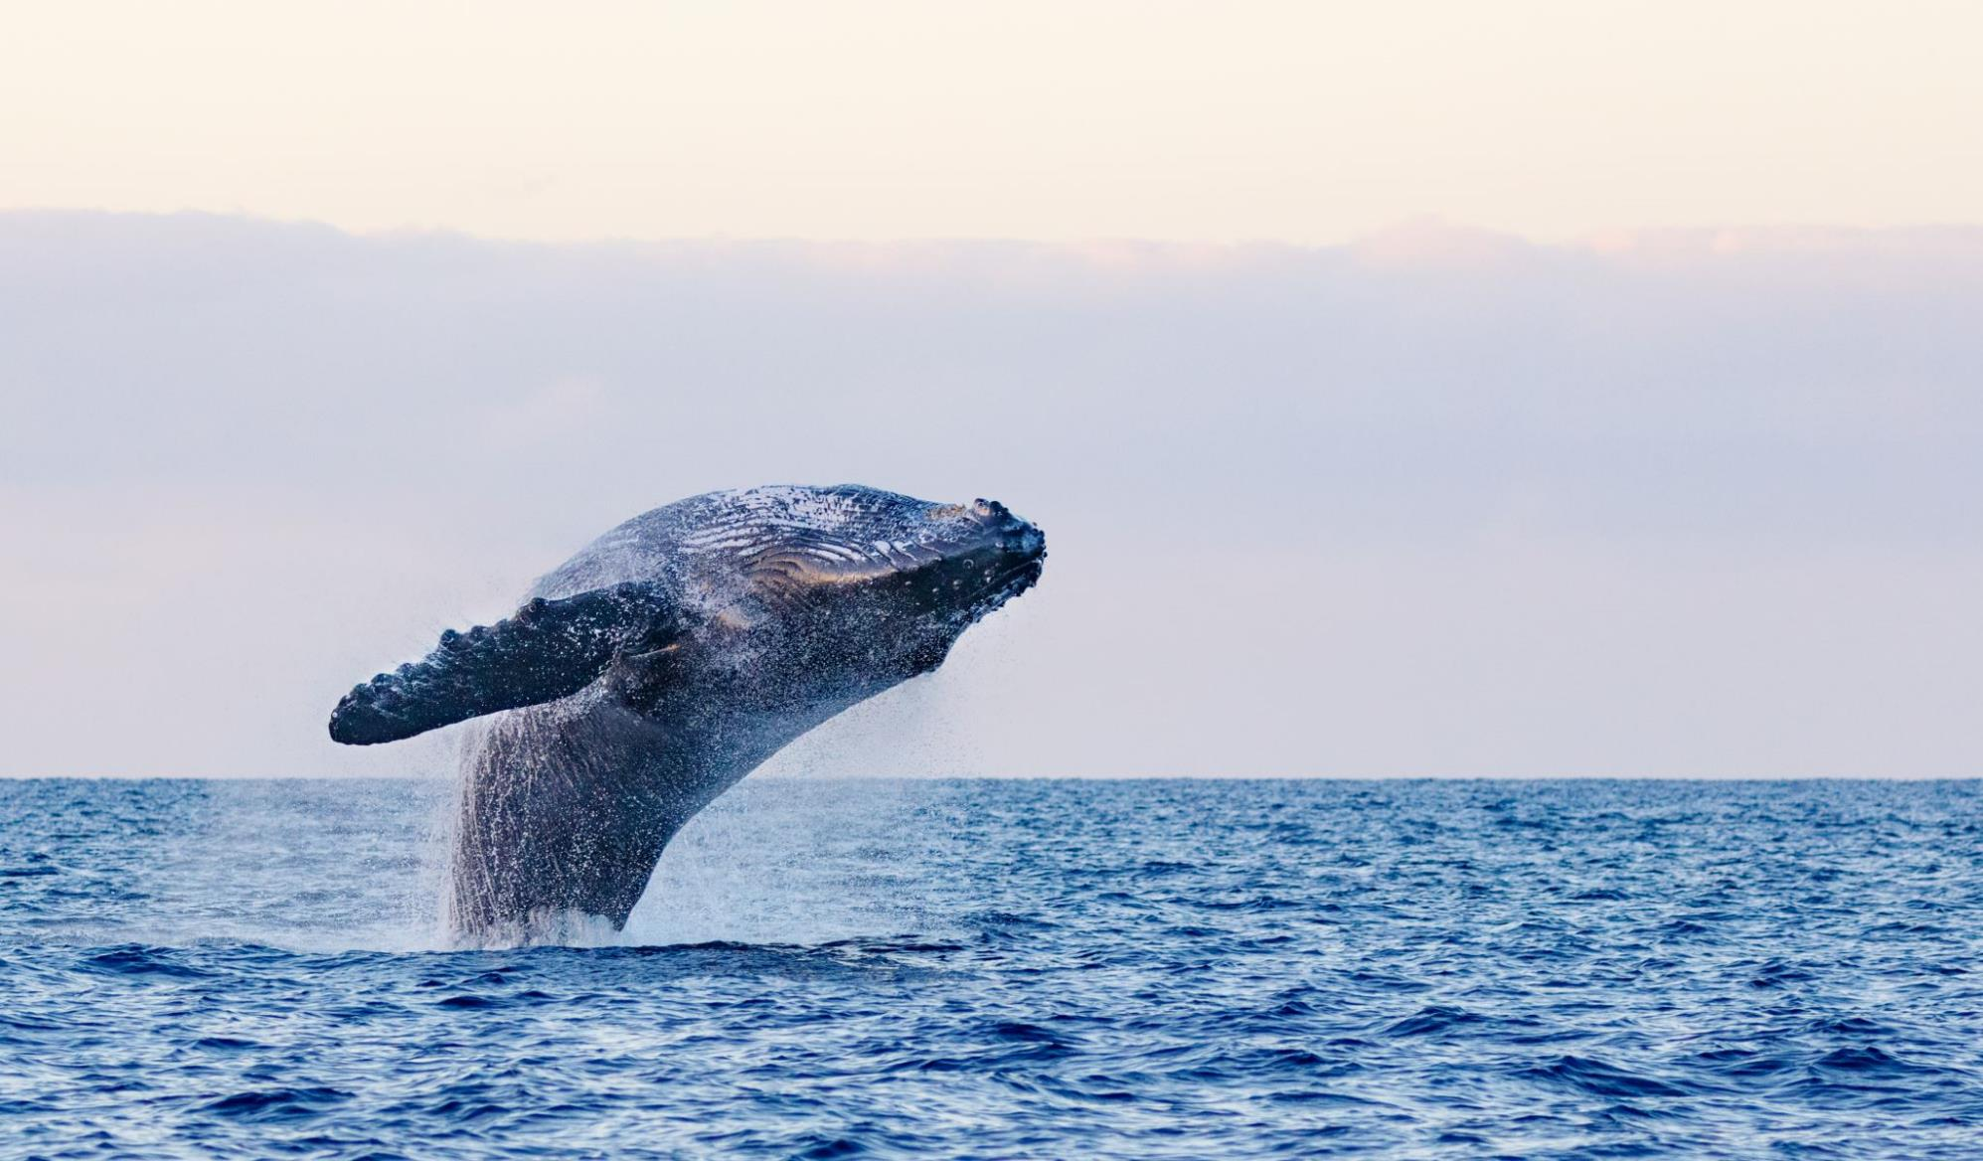
Whales are big

Slide 8
The machine weighs 20500 Kg

Slide 9
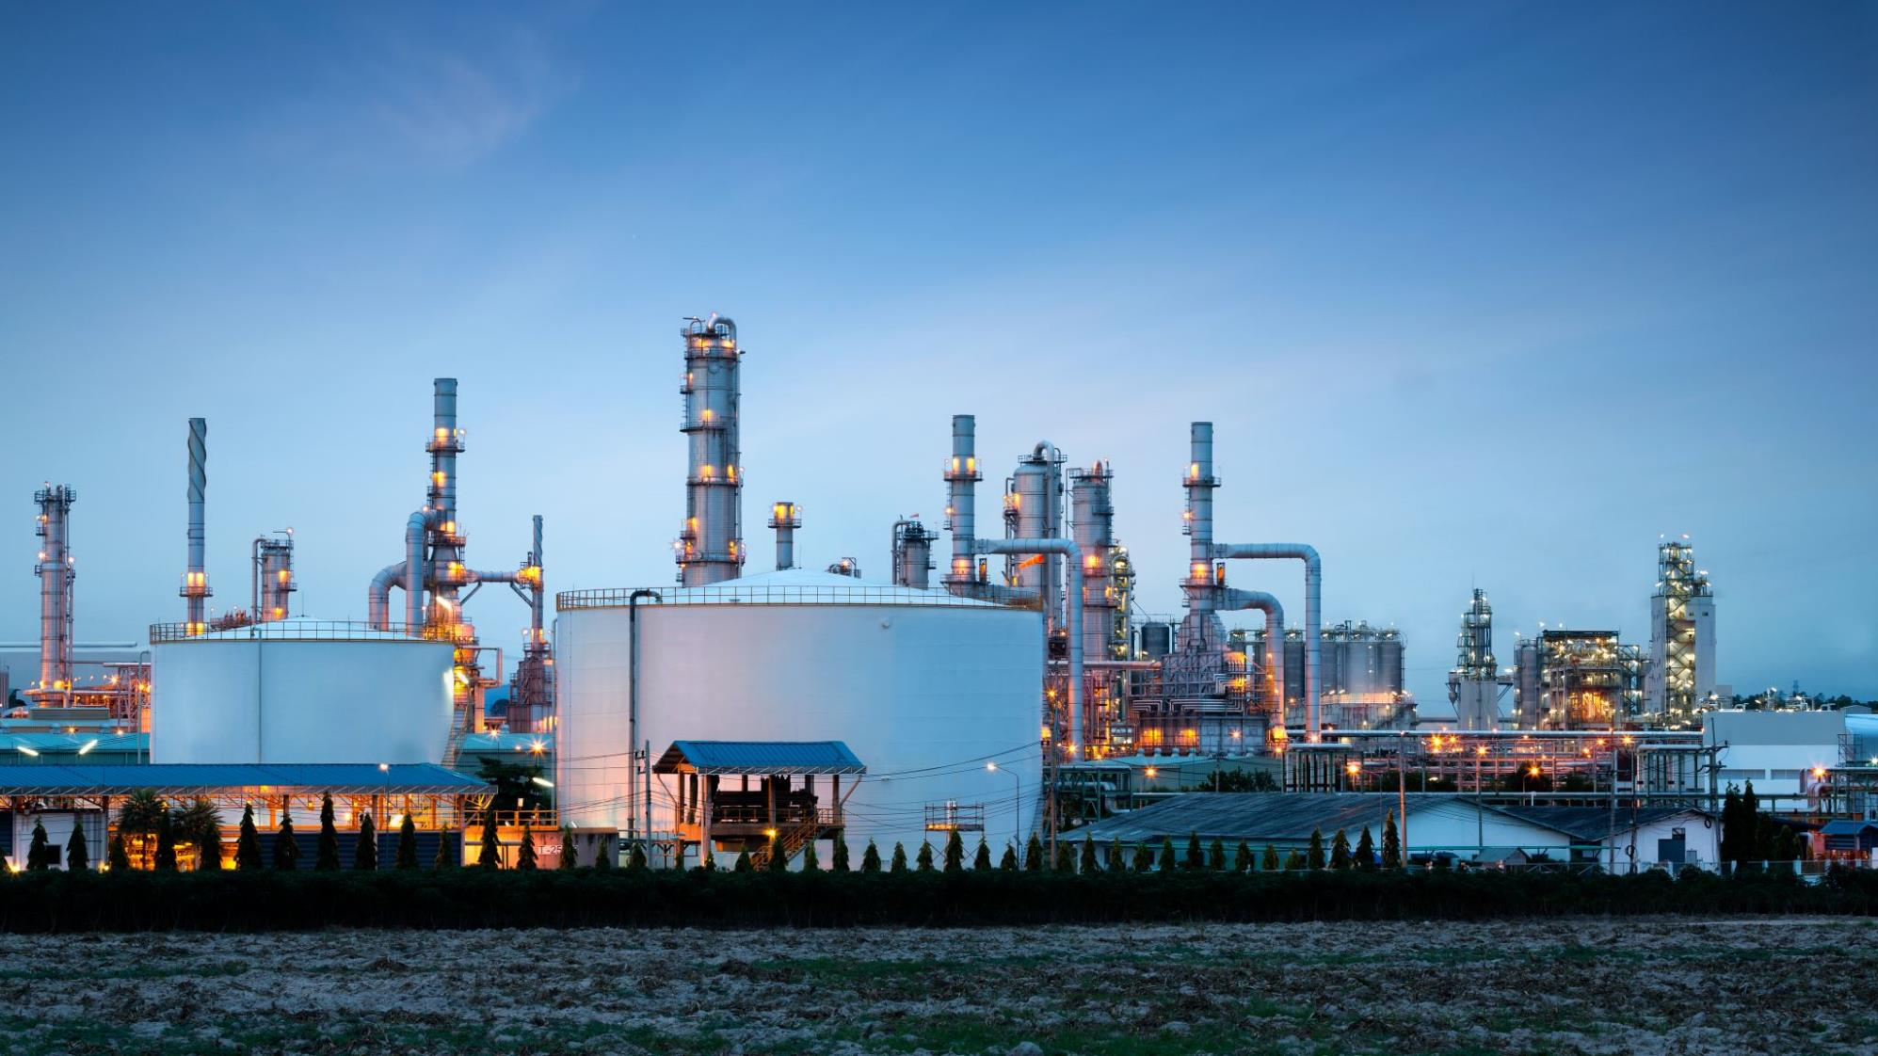
The machine is weighs 20500 kg
About twice the weight of a school bus

Slide 10
Velvet Curtain

Slide 11

Velvet Curtain

Slide 12
Timeline
2013 – Idea
2015 – Design
2017 – Testing
2018 – Manufacturing
2020 - Launch

Slide 13
Timeline
2013
Idea
2015
Design
2017
Testing
2018
Manufacturing
2020
Launch

Slide 14
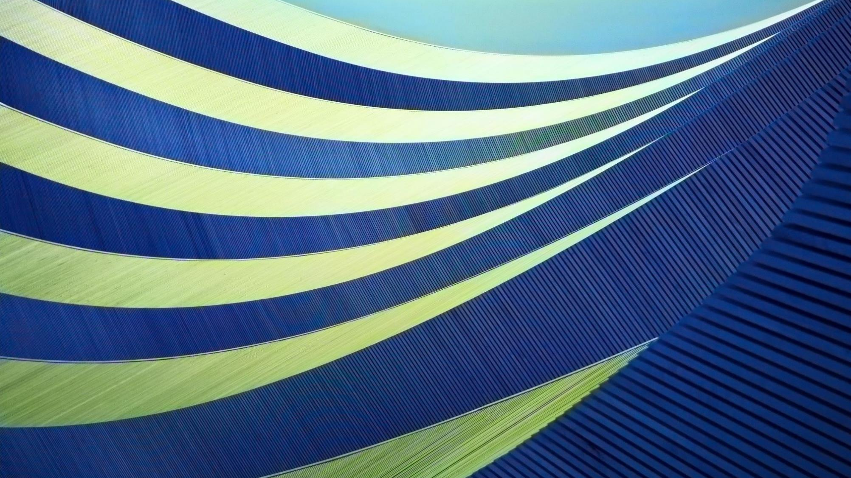
Timeline
2000
Idea
2015
Design
2017
Testing
2018
Manufacturing
2020
Launch

Slide 15
Project Management
Tasks
Time
People
Material
Cost

Slide 16
Project Management
Tasks
Time
Workers
Material
Cost

Slide 17

Project Management
Tasks
Time
People
Material
Cost

Slide 18
Office saves 104845 minutes in a year

Slide 19
Office saves 104845 minutes in a year

Slide 20

Office saves 104845 minutes in a year
About 2 and a half months

Slide 21
Summary
Profit increased
Revenue decreased
Quality is same

Slide 22
Summary
Profit increased
Revenue decreased
Quality is same

Slide 23
Cat

Slide 24
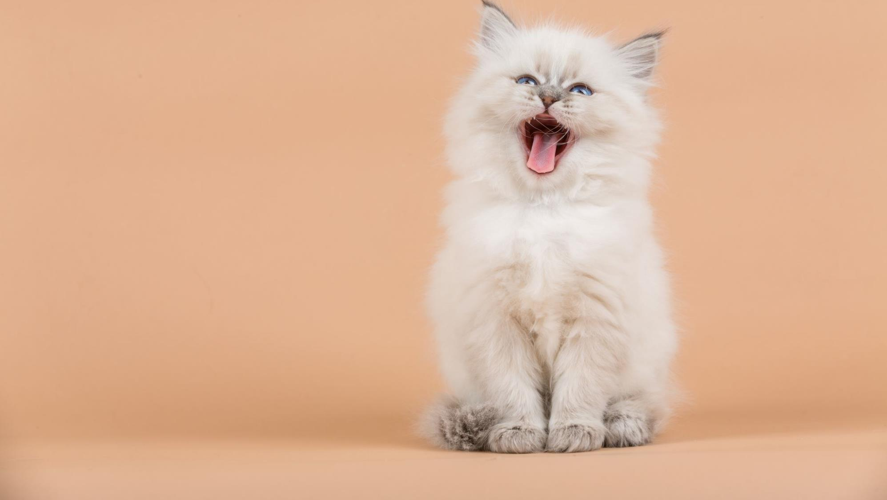
Cat

Slide 25
Unicorn

Slide 26

Unicorn

Slide 27
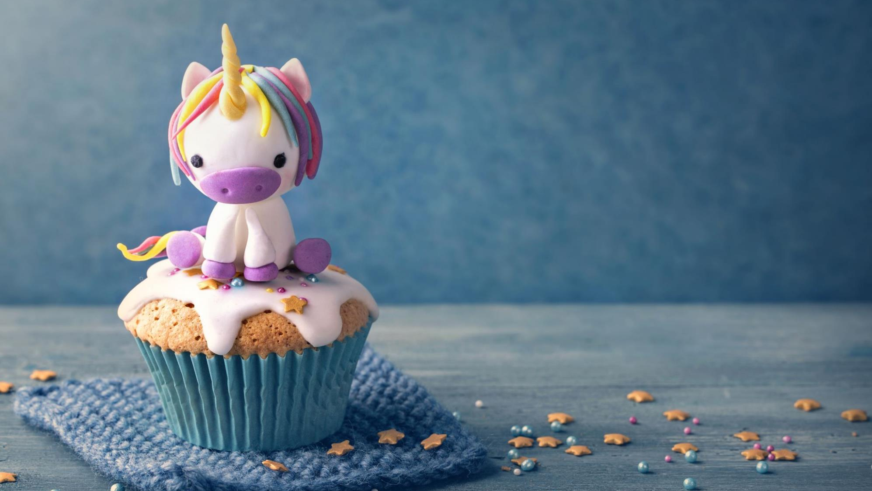
Unicorn

Slide 28
Process
Explore
Learn
Apply
Share
Grow

Slide 29
Process
Explore
Learn
Apply
Share
Grow

Slide 30

Process
Explore
Learn
Apply
Share
Grow

Slide 31
Process
Explore
Learn
Apply
Share
Grow

Slide 32

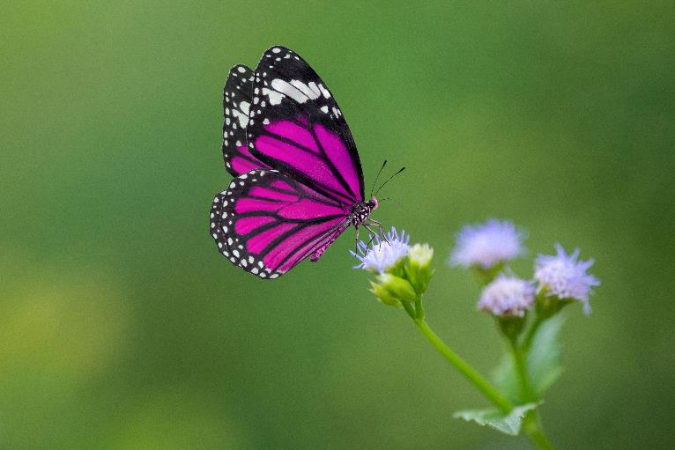

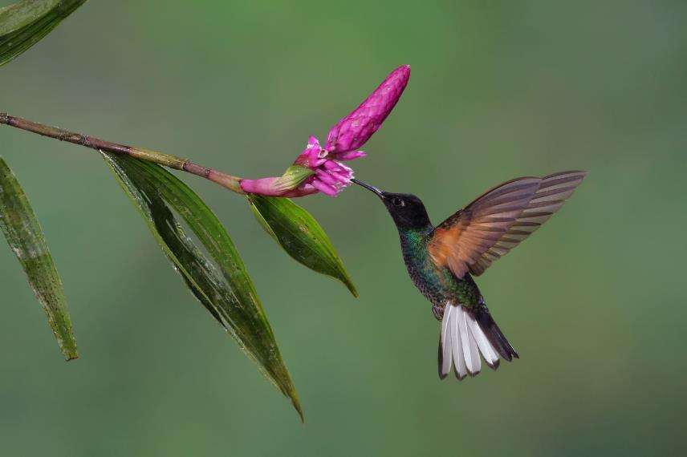

Flowers

Slide 33

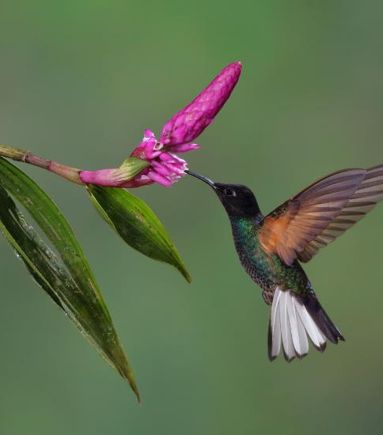



Flowers

